Slide 1



Breast Ultrasound Image Segmentation & Classification
Notes:
1

Slide 2


The Problem Statement
Goal: Build a model that can both segment breast lesions and classify ultrasound images as normal, benign, or malignant.
Dataset: Analyze image files and labels; preprocess by resizing, normalizing, denoising, and verifying masks.
Model: Design a Multi-Task U-Net with:
Shared encoder
Segmentation decoder (U-Net style)
Classification head from bottleneck
Training: Use a combined loss (segmentation + classification), apply joint backpropagation
Evaluation:
Segmentation: Dice score, mIoU, pixel accuracy
Classification: Accuracy, precision, recall, F1-score
Notes:
2

Slide 3


Dataset Overview
Total Images: 780
Format: PNG (converted from DICOM)
Image Size: Approximately 500 × 500 pixels
Classes:
Benign: 487 images
Malignant: 210 images
Normal: 133 images
Steel does not leach harmful chemicals into food, unlike some plastics.
Notes:
3

Slide 4
Data Preprocessing
Convert images to grayscale and resize to 256×256.
Apply Gaussian blur and normalize pixel values.
Combine lesion masks into binary masks.
Assign labels (0 = Benign, 1 = Malignant).
One-hot encode labels and split into train/test sets.
Why U-Net?
Effective for medical image segmentation with limited data.
Preserves spatial detail using skip connections.
Proven success in tumor detection tasks.
Steel does not leach harmful chemicals into food, unlike some plastics.
Notes:
3

Slide 5

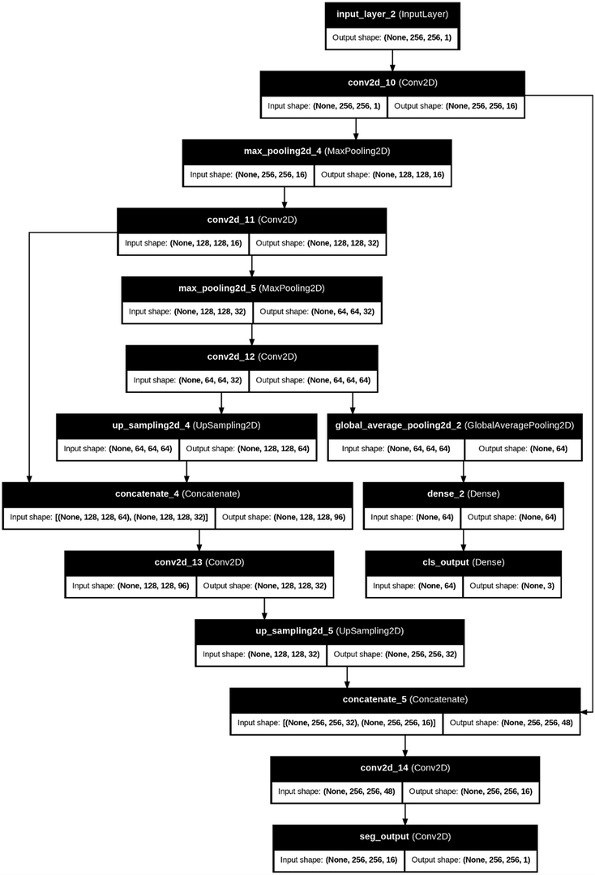

Model Architecture: Multi-Task U-Net
Bottleneck: Deepest feature layer before decoding.
Segmentation Decoder: Upsampling + skip connections to predict lesion mask.
Classification Head:
Global average pooling of bottleneck.
Dense layers to predict class (benign/malignant).
Input: Grayscale image (256×256×1).
Encoder: Convolution + pooling to extract features.
Notes:
4

Slide 6

Training Strategy
Loss: Weighted sum of Dice loss (segmentation) + cross-entropy (classification).
Optimization: Joint backpropagation with learning rate scheduling, early stopping.
Evaluation Metrics
Segmentation: Dice score, mIoU, pixel accuracy.
Classification: Accuracy, precision, recall, F1-score.
Notes:
5

Slide 7


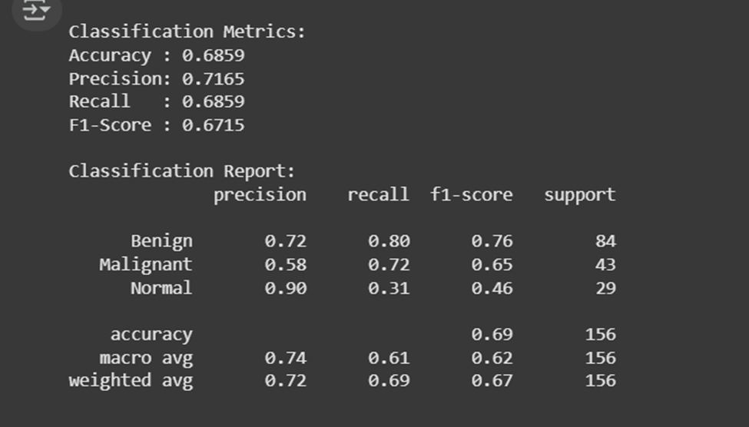
Results
Notes:
6

Slide 8

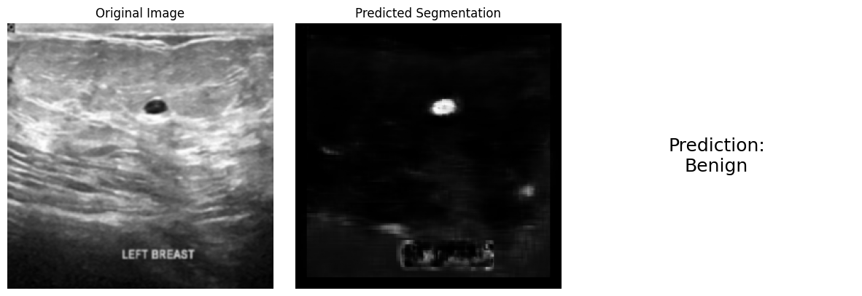
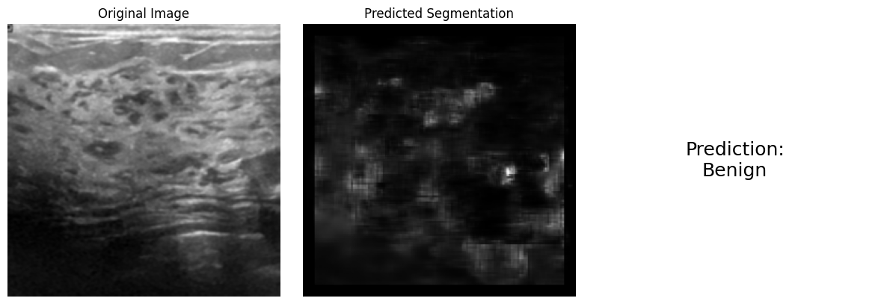
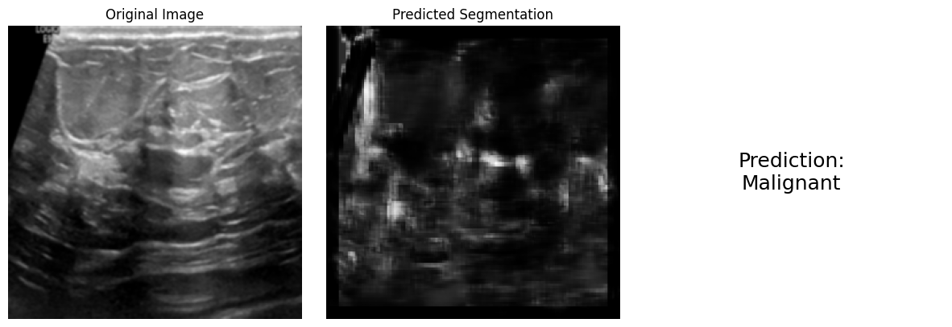
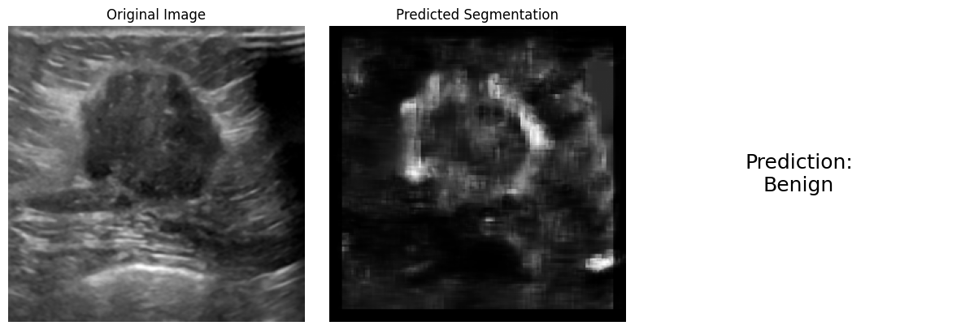
Test Case
Notes:
7

